Slide 1
Beyond ChatGPT:
Open-source Aligned LLMs
Daniel Hershcovich

Slide 2

What ChatGPT is(n't)
It is a
Free/paid service by OpenAI
It is NOT
Trustworthy or reliable (due to, e.g., “hallucinations”)
Particularly environmentally friendly
Open source/model/data nor transparent
Up-to-date (trained in 2021/2023)
LLM (large language model) which is a GPT (generative pre-trained transformer) fine-tuned ("aligned") for chat/instruction following
Backend powered by
Frontend web interface

Slide 3
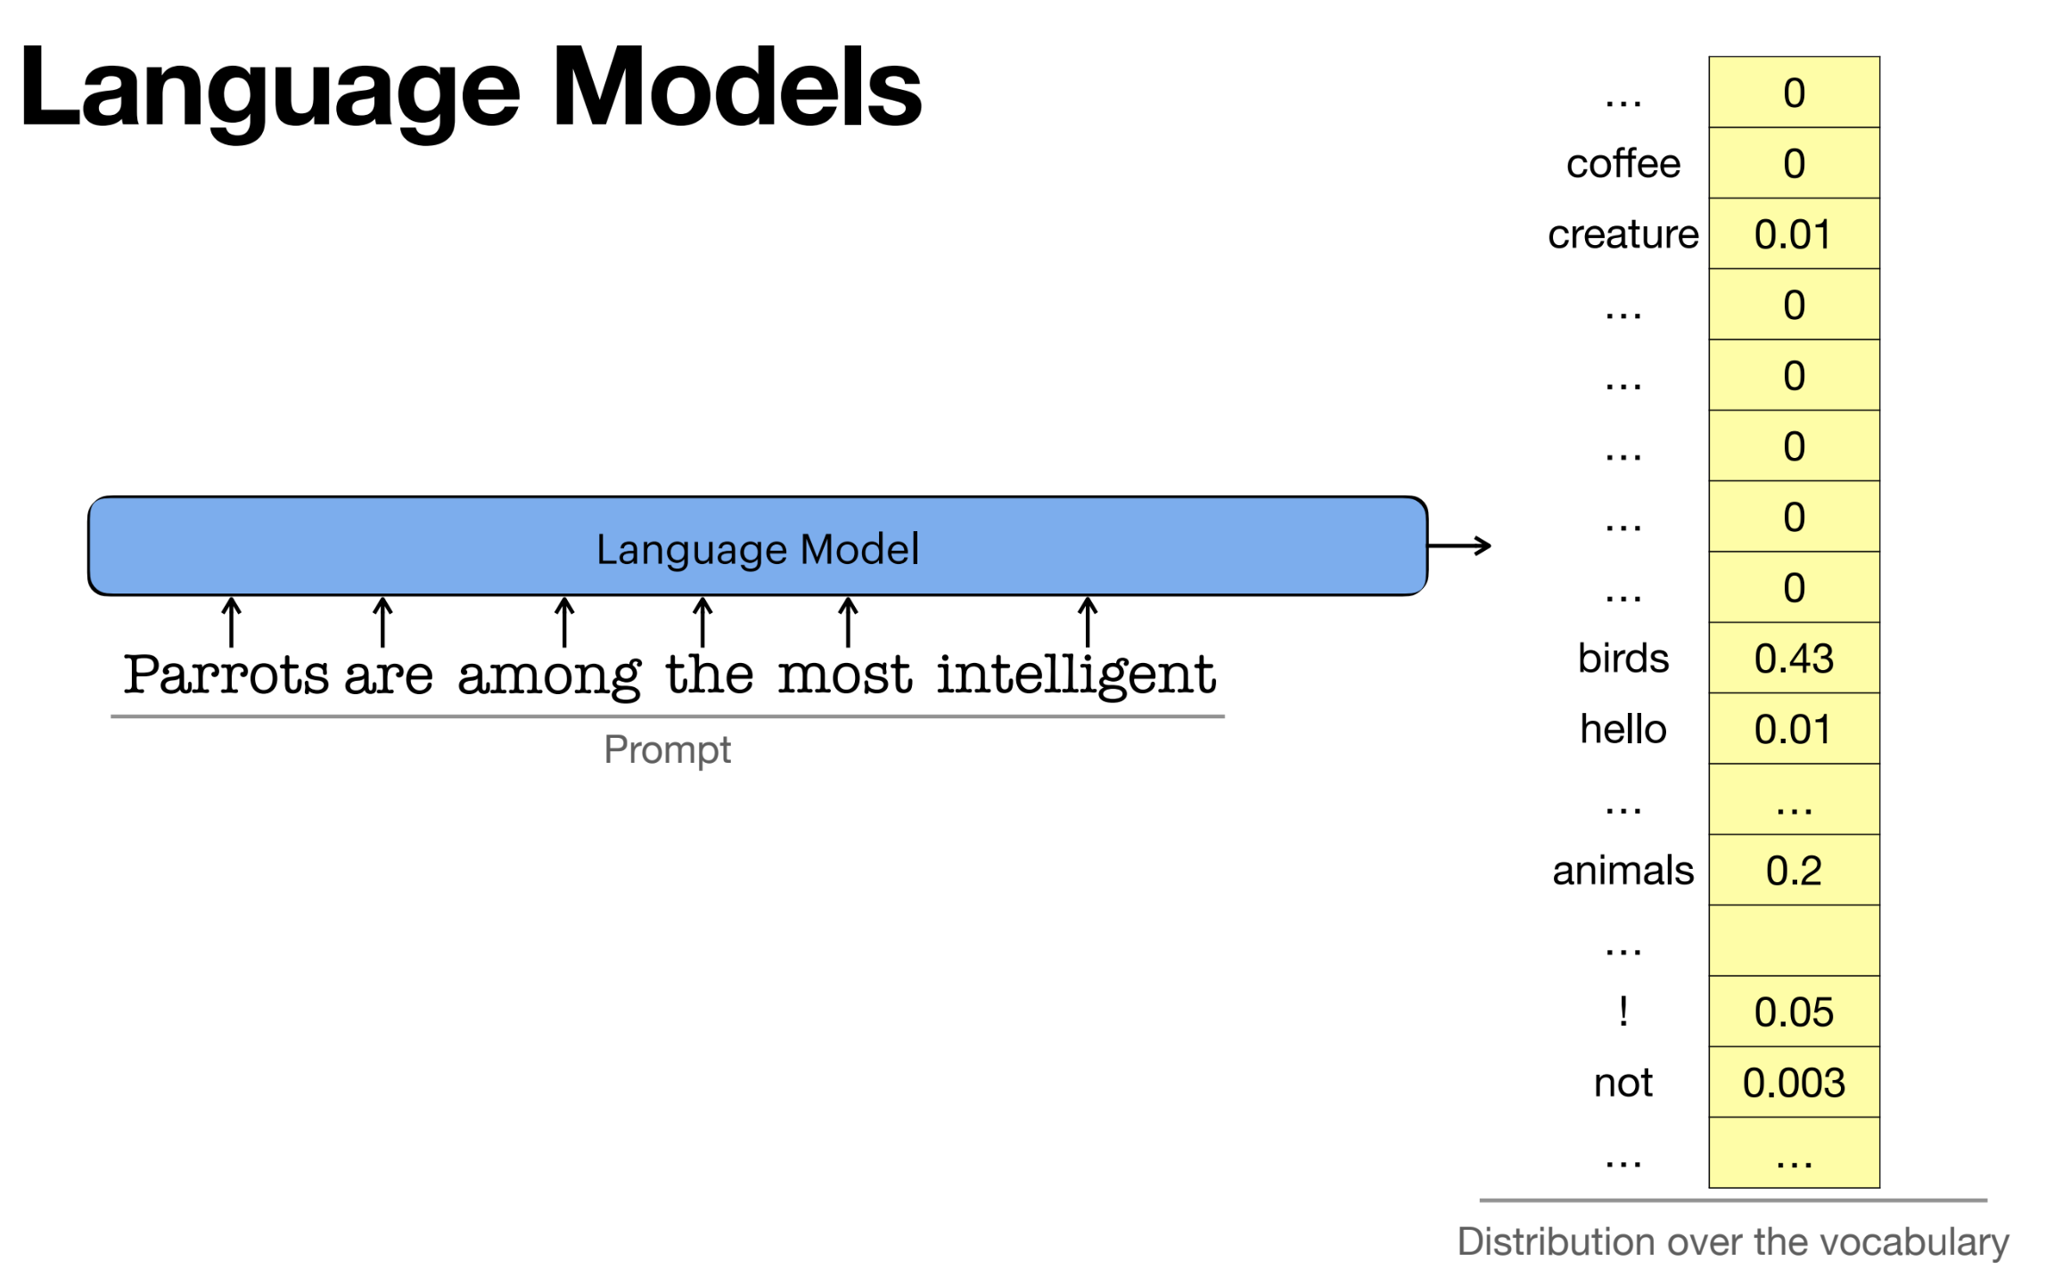
Vered Shwartz, Everything you wanted to know about ChatGPT

Slide 4
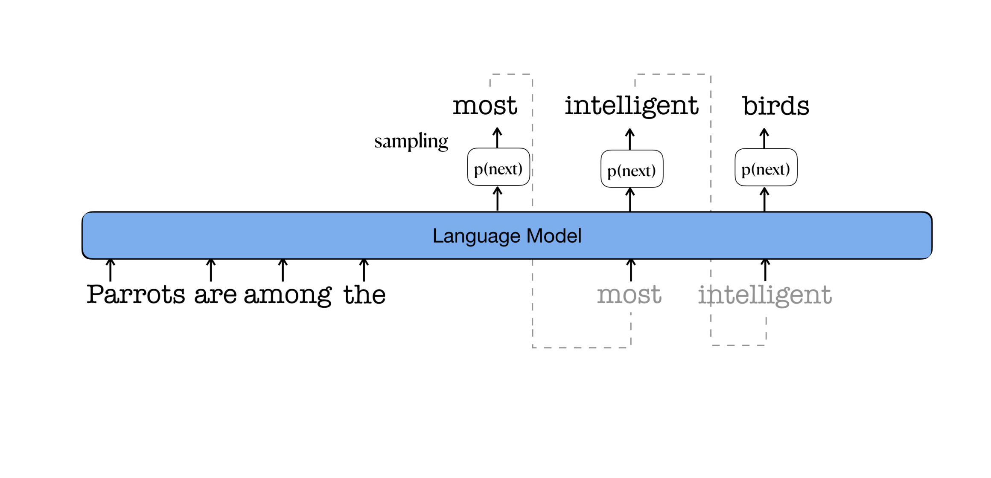
Generative (decoder) LMs
Vered Shwartz, Everything you wanted to know about ChatGPT

Slide 5
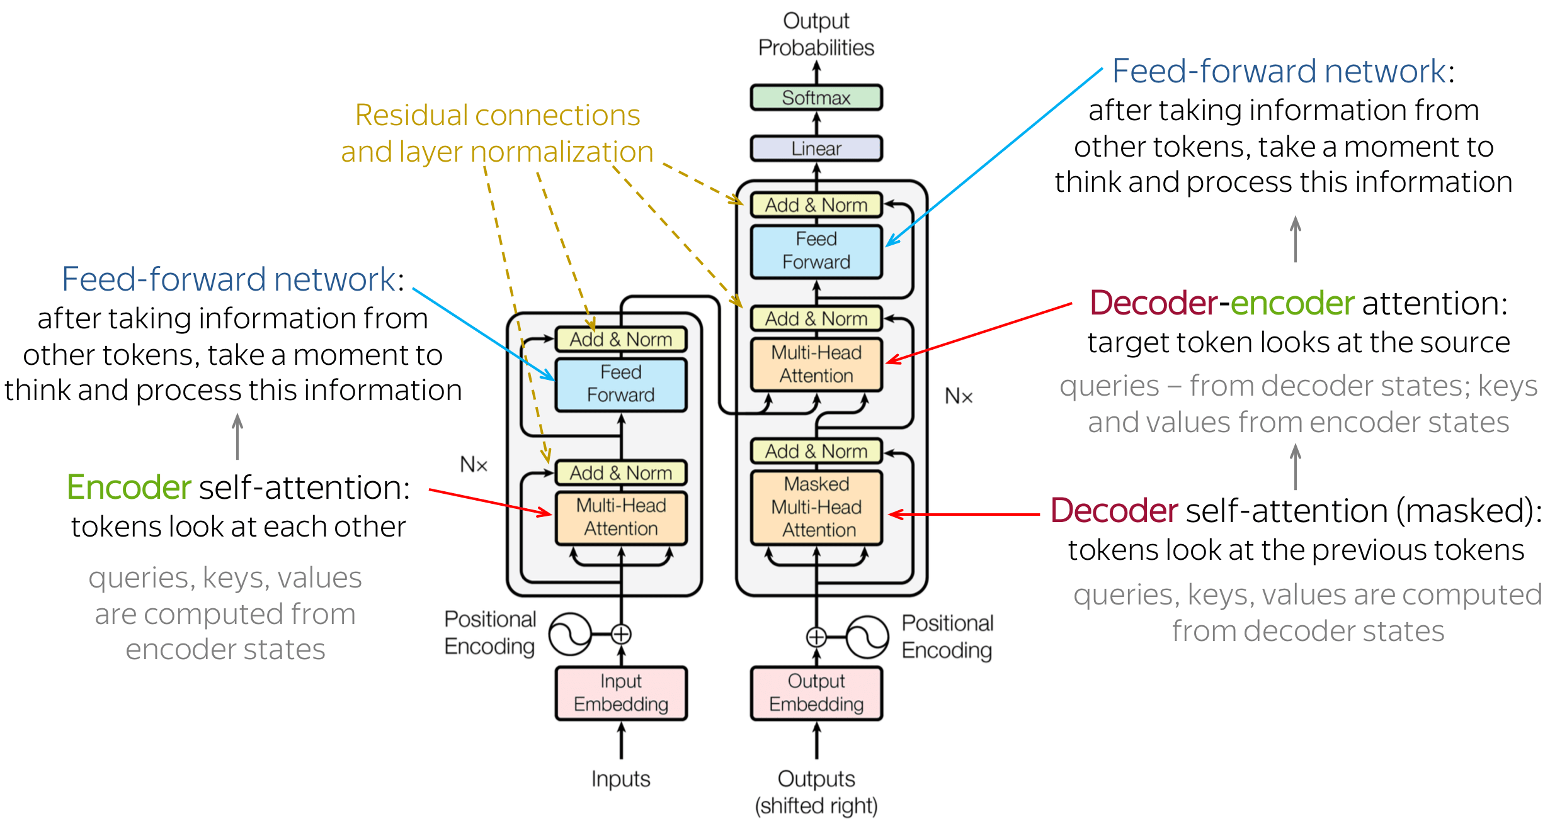
Transformer
https://lena-voita.github.io/nlp_course/seq2seq_and_attention.html

Slide 6
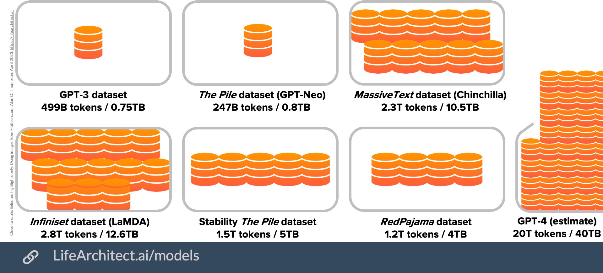
Pre-training base models

Slide 7
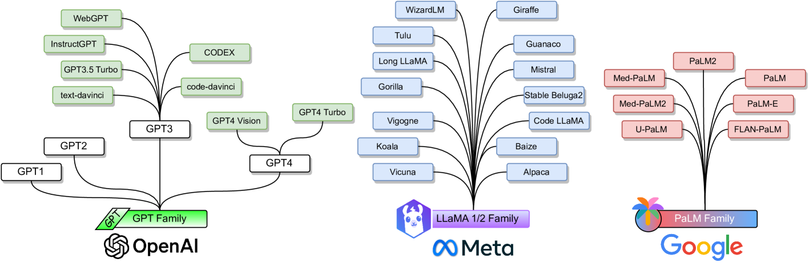
Popular LLM families
Minaee, Shervin, et al. "Large language models: A survey." arXiv preprint arXiv:2402.06196 (2024).

Slide 8
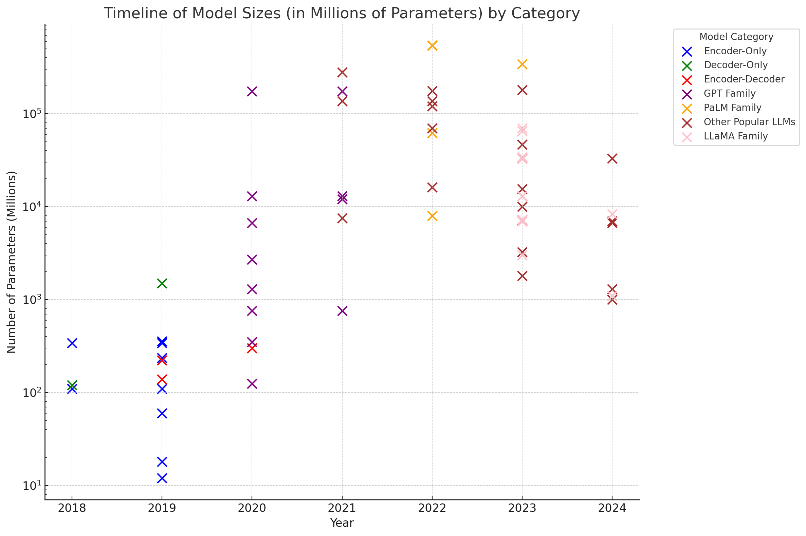
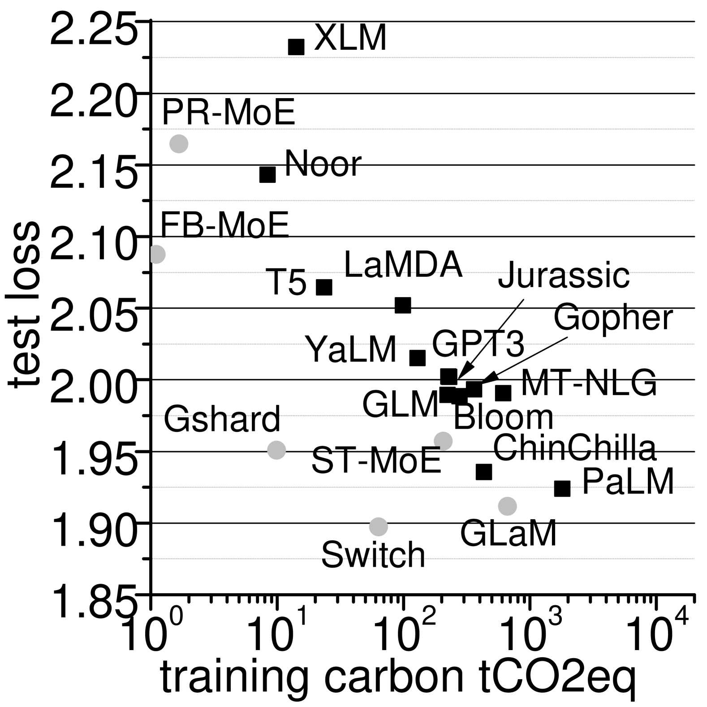
LLM size and emissions
Faiz, Ahmad, et al. "LLMCarbon: Modeling the end-to-end Carbon Footprint of Large Language Models." arXiv preprint arXiv:2309.14393 (2023).
Minaee, Shervin, et al. "Large language models: A survey." arXiv preprint arXiv:2402.06196 (2024).

Slide 9
Some definitions for “alignment” of models
Alignment: General notion of training a model to mirror user desires
Supervised fine-tuning (SFT): Training to learn task-specific capabilities
Instruction fine-tuning (IFT): Training a model to follow instructions
Reinforcement learning from human feedback (RLHF): Specific technical tool for training ML models from human data
Preference fine-tuning: Using labeled preference data to fine-tune a LM (either with RL, DPO, or another loss function)
Aligning open language models (Nathan Lambert, April 2024)

Slide 10
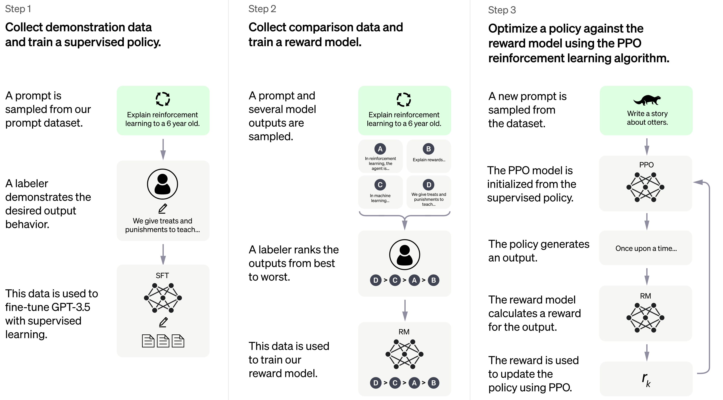
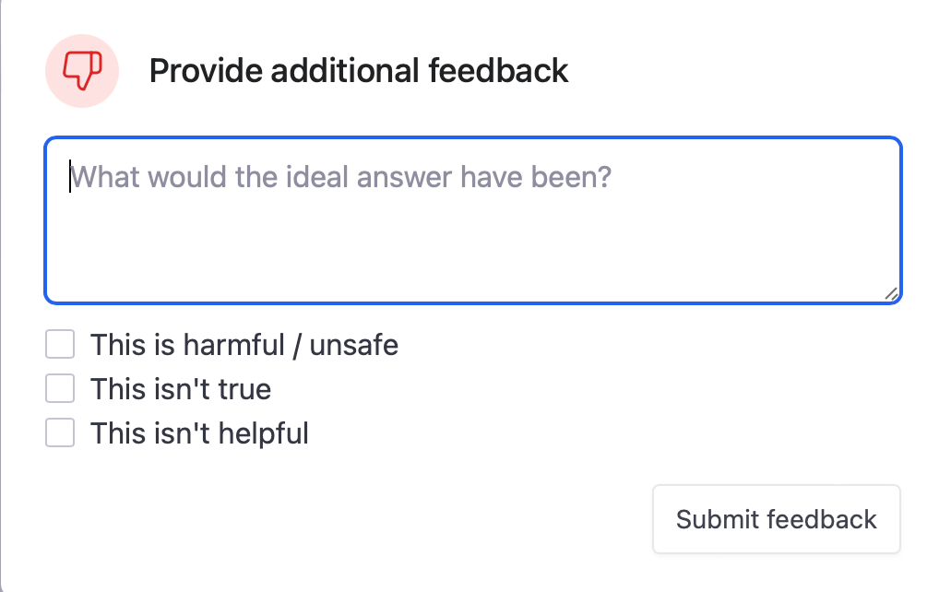
RLHF in ChatGPT
https://openai.com/blog/chatgpt

Slide 11
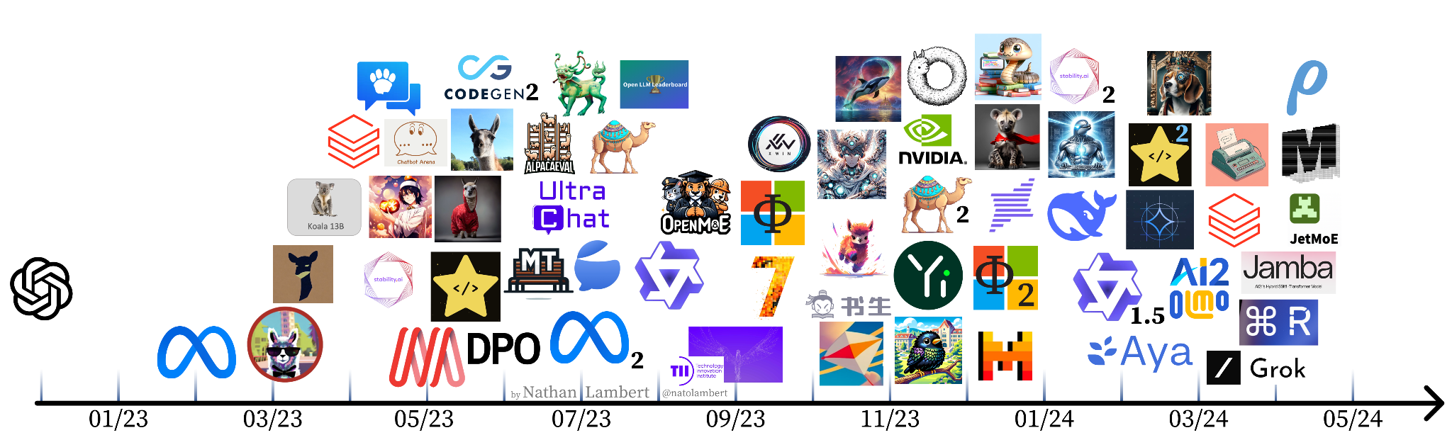

Aligning open language models
1: instruction tuning blooms
2: evals & expectations
3: RLHF works!
4. expansion
Aligning open language models (Nathan Lambert, April 2024)

Slide 12
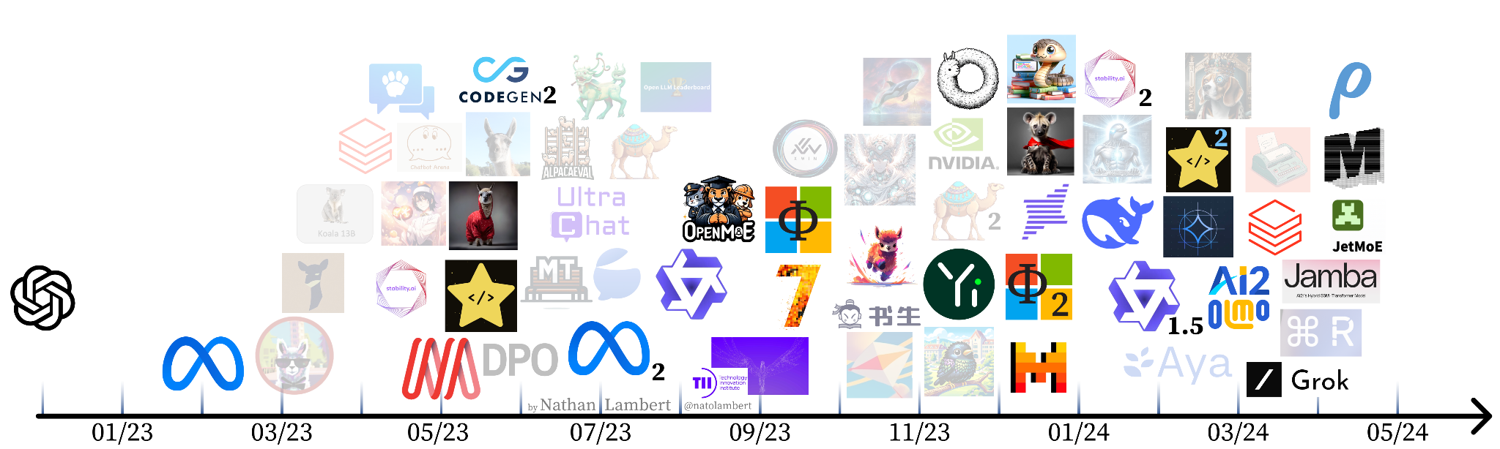
Base models
Aligning open language models (Nathan Lambert, April 2024)

Slide 13
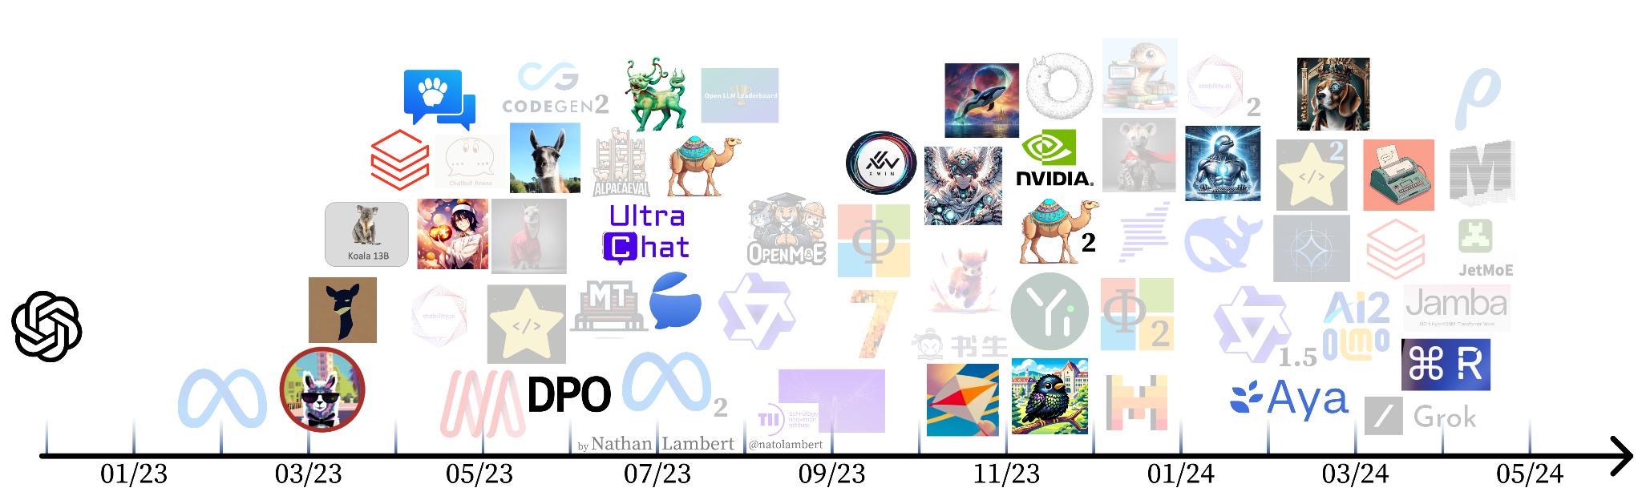
Aligned / fine-tuned / preference trained models
Aligning open language models (Nathan Lambert, April 2024)

Slide 14
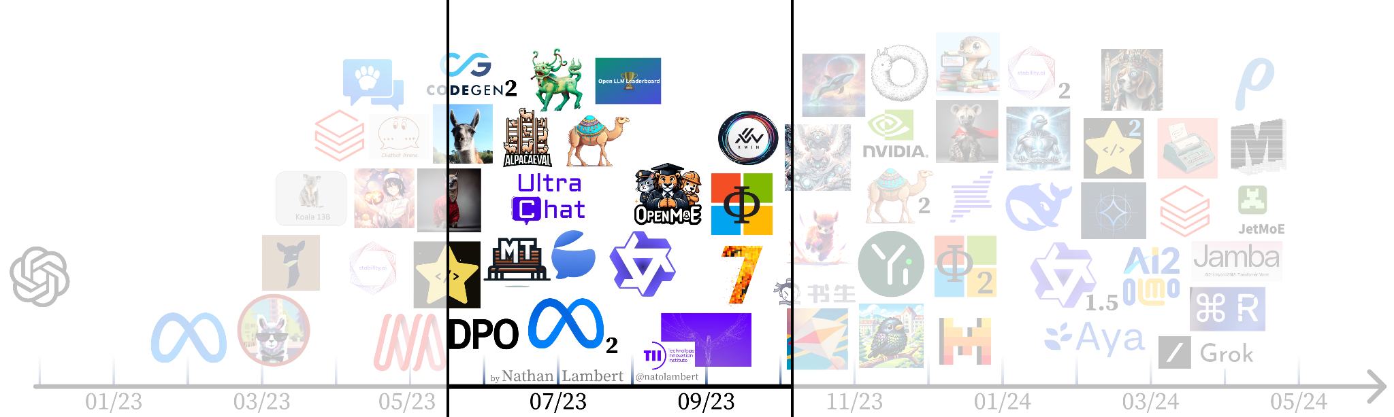
Setting expectations & evaluations

Slide 15
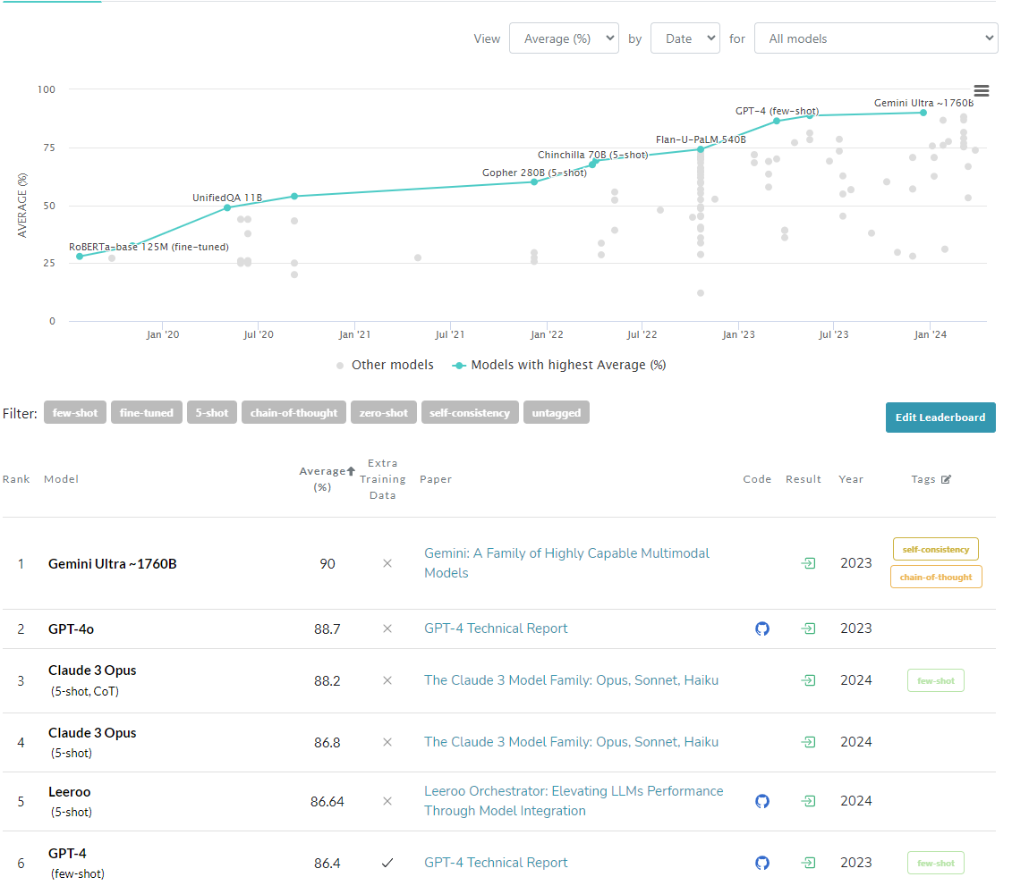
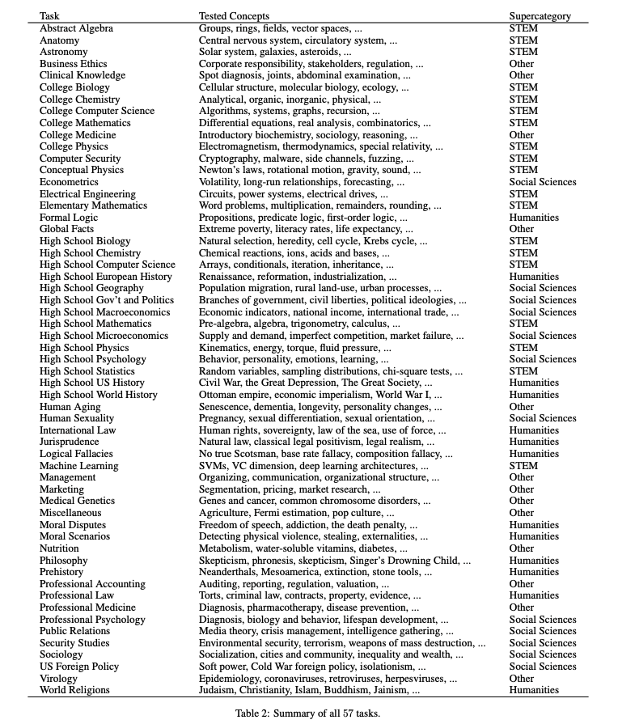
Prehistory: MMLU benchmark
September 2020
Massive Multitask Language Understanding
57 tasks including elementary mathematics, US history, computer science, law
Only multiple-choice questions
Hendrycks, Dan, et al. "Measuring massive multitask language understanding." arXiv preprint arXiv:2009.03300 (2020).

Slide 16
Establishing evaluation for generative models
The four most popular aligned model evaluations of the past year were created within 2 months of each other!
May 3rd, 2023: ChatBotArena
June 8th, 2023: AlpacaEval
June 22nd, 2023: MT Bench
July 2023: Open LLM Leaderboard
Aligning open language models (Nathan Lambert, April 2024)

Slide 17
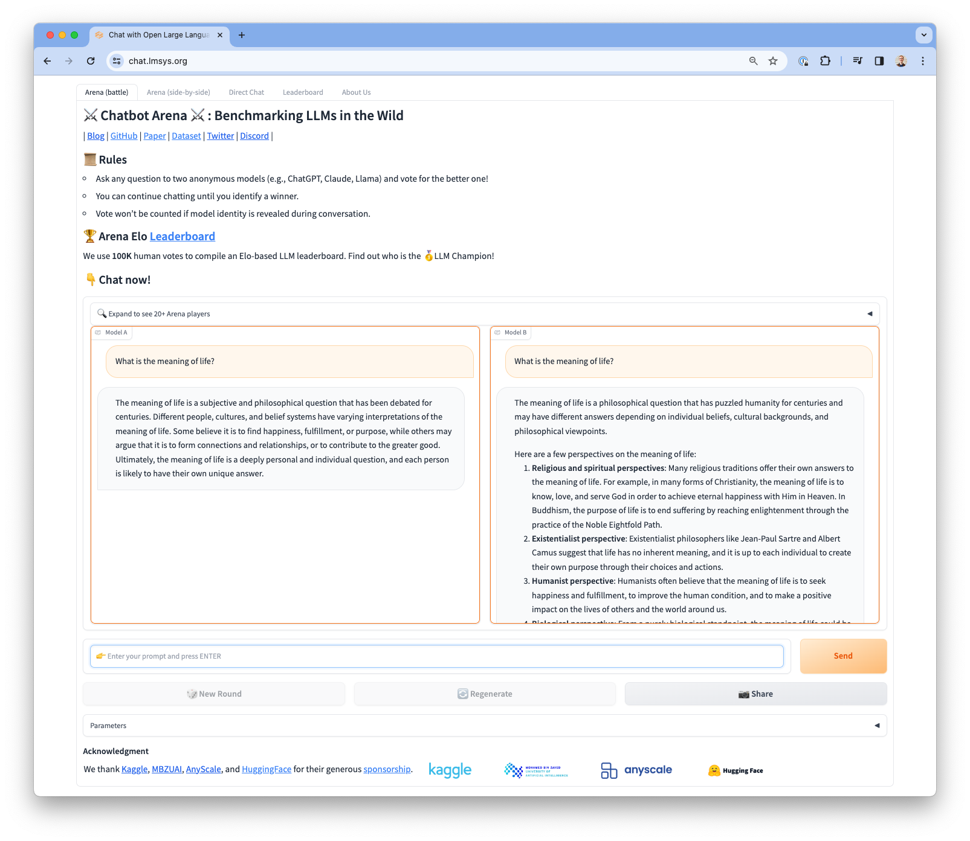
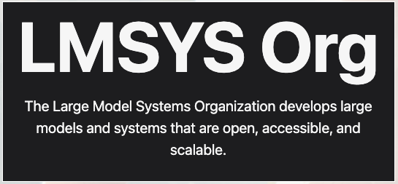
ChatBotArena
Side by side preference collection of two different models
Aligning open language models (Nathan Lambert, April 2024)

Slide 18
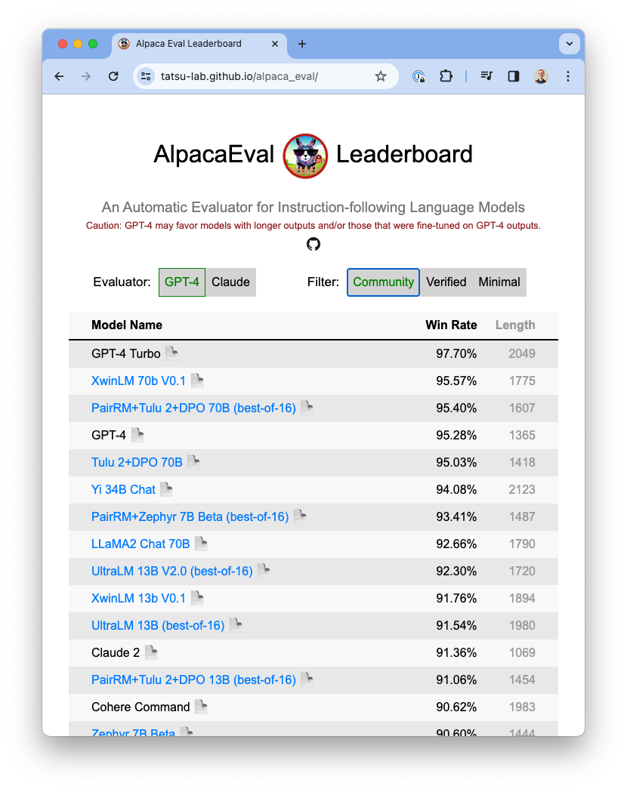
AlpacaEval
LLM-as-a-judge mirroring preference collection phase
Aligning open language models (Nathan Lambert, April 2024)

Slide 19
MT Bench
LLM-as-a-judge: ask an LLM (GPT4/Claude) to rate a model response
Zheng, Lianmin, et al. "Judging LLM-as-a-judge with MT-Bench and Chatbot Arena." arXiv preprint arXiv:2306.05685 (2023).
Aligning open language models (Nathan Lambert, April 2024)

Slide 20
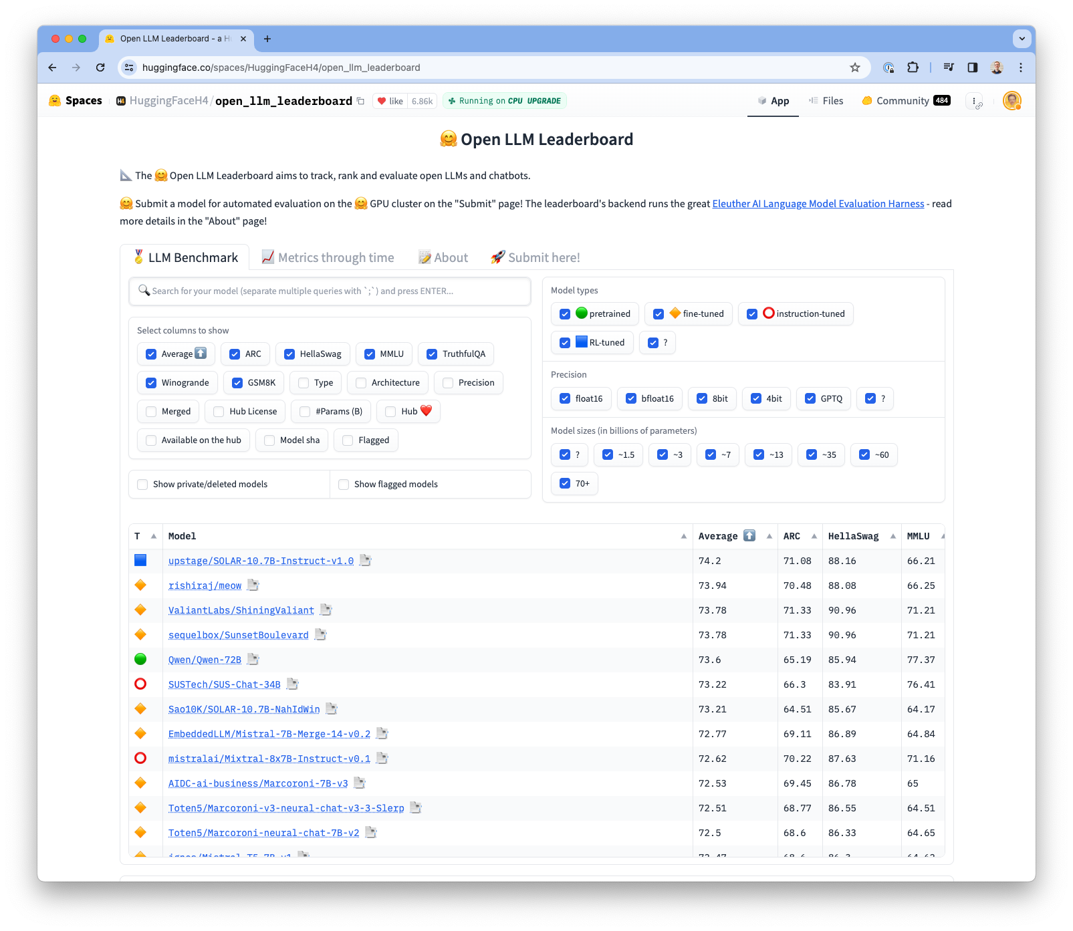
Open LLM Leaderboard
Evaluates almost any model on HuggingFace on core LLM tasks
RLHF has not been shown to improve these metrics deeply, starting to get better in 2024
Aligning open language models (Nathan Lambert, April 2024)

Slide 21
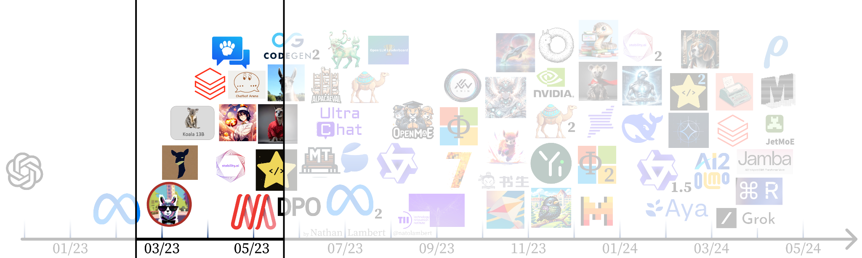
The first open instruct models
Aligning open language models (Nathan Lambert, April 2024)

Slide 22
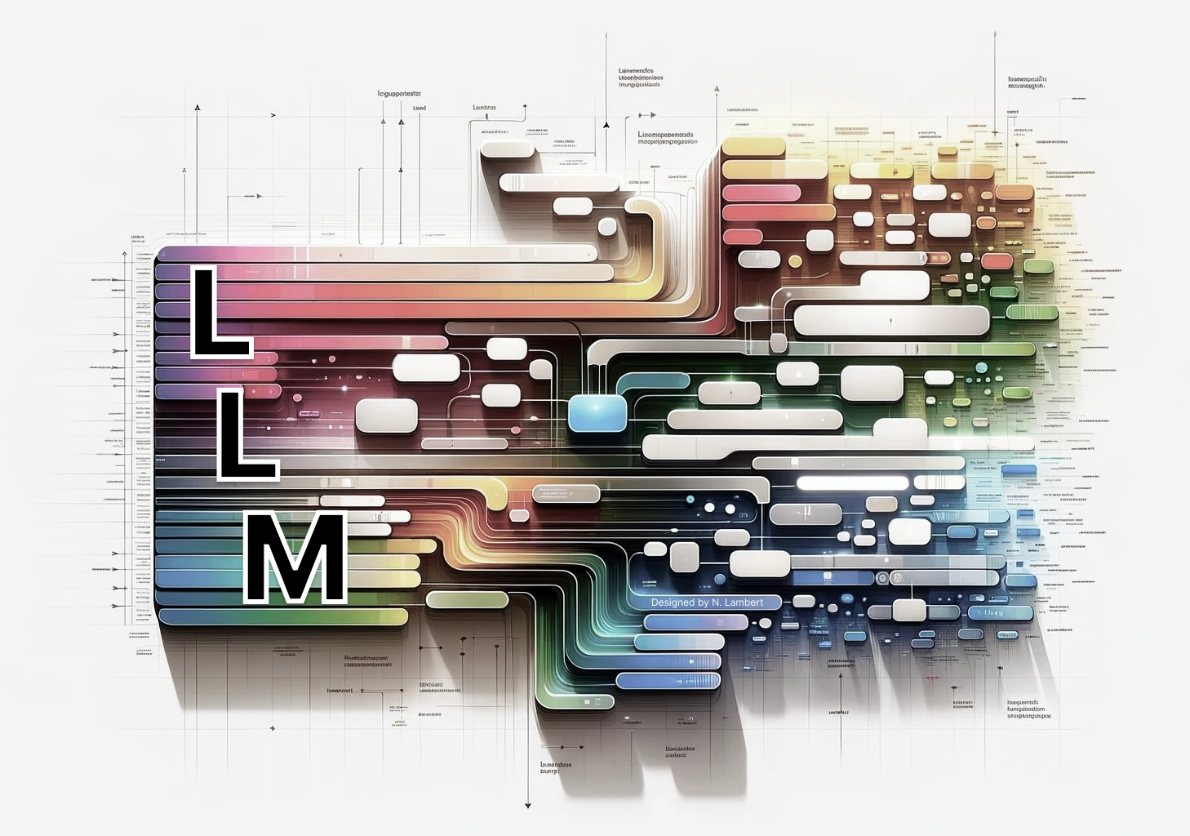
Key idea: Instruction fine-tuning (IFT)
Adapt base model to specific style of input
Ability to include system prompts, multi-turn dialogues, and other chat templates
Aligning open language models (Nathan Lambert, April 2024)

Slide 23
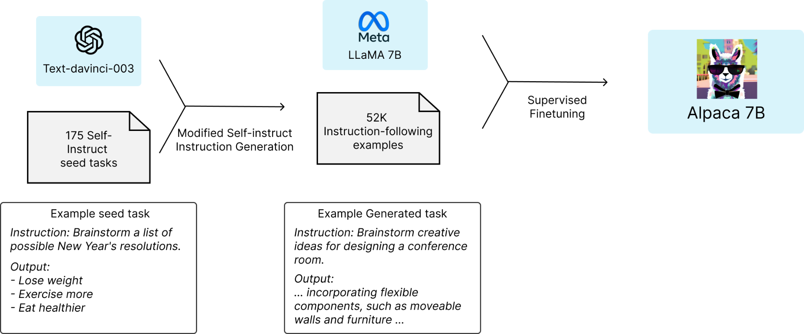
Key idea: Self-instruct / synthetic data
Start: high-quality (often human) prompts
Ask a strong LM: Create a modified version of these instructions
Generate completions with another (or same) strong LM
End: easily 10x more (synthetic) training data!
(synthetic data = text generated by another LLM)
Taori et al. 2023.
Self-instruct: Wang et al. 2022
Aligning open language models (Nathan Lambert, April 2024)

Slide 24

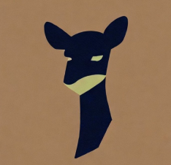
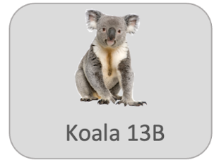

First open instruction tuned models
MT Bench 13B: 4.53
MT Bench 7B: 6.69
Alpaca
13 Mar. 2023
52k self-instruct style data distilled from text-davinci-003
Model weight diff. to LLaMA 7B
https://crfm.stanford.edu/2023/03/13/alpaca.html
Vicuna (lmsys/vicuna-7b-delta-v0)
30 Mar. 2023
Fine-tunes ChatGPT data from ShareGPT
LLaMA 7B and 13B diff’s
Introduces LLM-as-a-judge
https://lmsys.org/blog/2023-03-30-vicuna/
Koala
3 Apr. 2023
Diverse dataset (Alpaca, Anthropic HH, ShareGPT, WebGPT…)
Human evaluation
LLaMA 7B diff.
https://bair.berkeley.edu/blog/2023/04/03/koala/
MT Bench 13B: 6.08
Dolly
12 Apr. 2023
15k human written data
Trained on Pythia 12b
https://www.databricks.com/blog/2023/04/12/dolly-first-open-commercially-viable-instruction-tuned-llm
MT Bench 12B: 3.28
Aligning open language models (Nathan Lambert, April 2024)

Slide 25

OpenAssistant: The first open, human instruction dataset
“In an effort to democratize research on large-scale alignment, we release OpenAssistant Conversations (OASST1), a human-generated, human-annotated assistant-style conversation corpus consisting of 161,443 messages in 35 different languages, annotated with 461,292 quality ratings, resulting in over 10,000 fully annotated conversation trees. The corpus is a product of a worldwide crowd-sourcing effort involving over 13,500 volunteers.”
April 15th, 2023
Used extensively in future models.
Still the only human dataset of this size to be released.
OpenAssistant and others trained the popular models with it.
(released fine-tuned models too!)
Dataset: https://huggingface.co/datasets/OpenAssistant/oasst1
Paper: https://arxiv.org/abs/2304.07327
Aligning open language models (Nathan Lambert, April 2024)

Slide 26

StableVicuna
28th April, 2023
The first open source RLHF model
Trained with proximal policy optimization (PPO) on popular datasets
OAsst1 dataset for SFT + PPO
Anthropic HH + Stanford Human Preferences (SHP) for RL
Model: https://huggingface.co/CarperAI/stable-vicuna-13b-delta
Blog: https://stability.ai/news/stablevicuna-open-source-rlhf-chatbot
Aligning open language models (Nathan Lambert, April 2024)

Slide 27
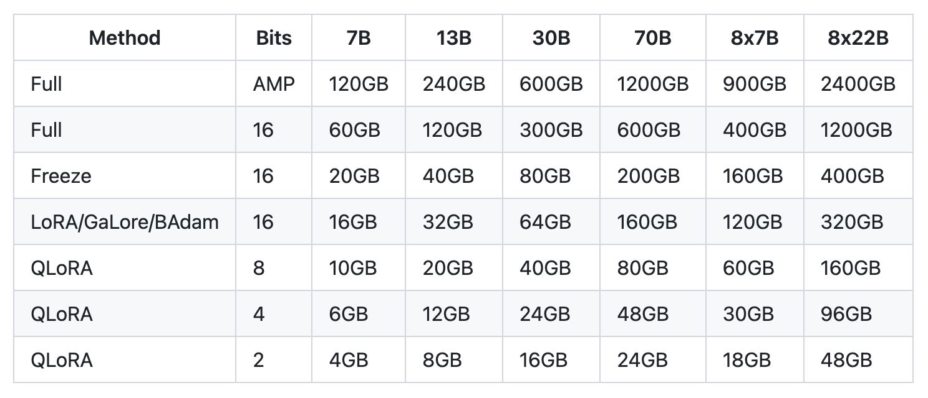
QLoRA
LoRA: Low Rank Adaptation
Popular tool for fine-tuning models with lower memory consumption.
QLoRA: LoRA + quantized base model (+ paging and double quantization)
Further reduce memory consumption of fine-tuning while (mostly) maintaining performance
Approximate VRAM requirements.
Source: https://github.com/hiyouga/LLaMA-Factory#hardware-requirement
Aligning open language models (Nathan Lambert, April 2024)

Slide 28
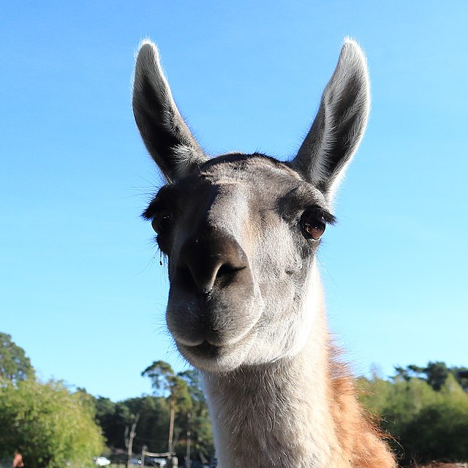
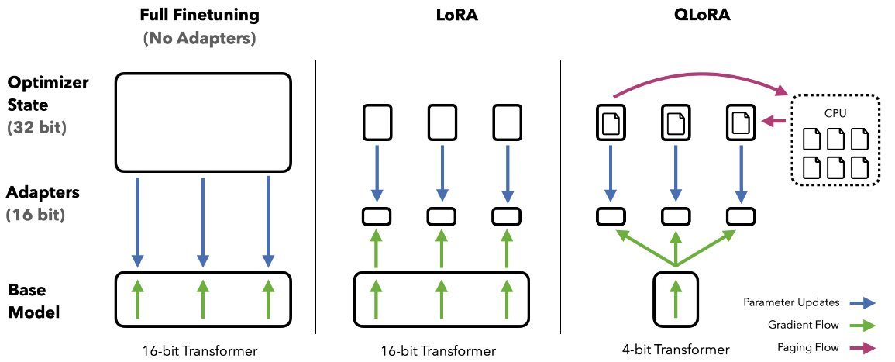
Guanaco
23rd May, 2023
First models trained with QLoRA + quality filtered Open Assistant dataset.
Both the dataset and QLoRA method are still regularly used
MT Bench: 6.88
Image credit: Tim Dettmers
Paper: https://arxiv.org/abs/2305.14314
Dataset: https://huggingface.co/datasets/timdettmers/openassistant-guanaco
Model: https://huggingface.co/timdettmers/guanaco-65b
Aligning open language models (Nathan Lambert, April 2024)

Slide 29
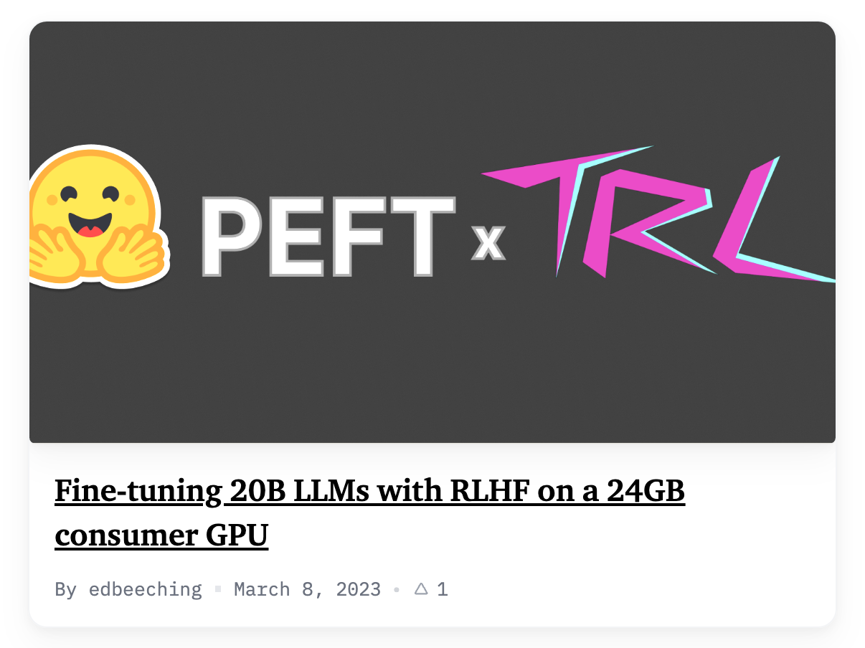
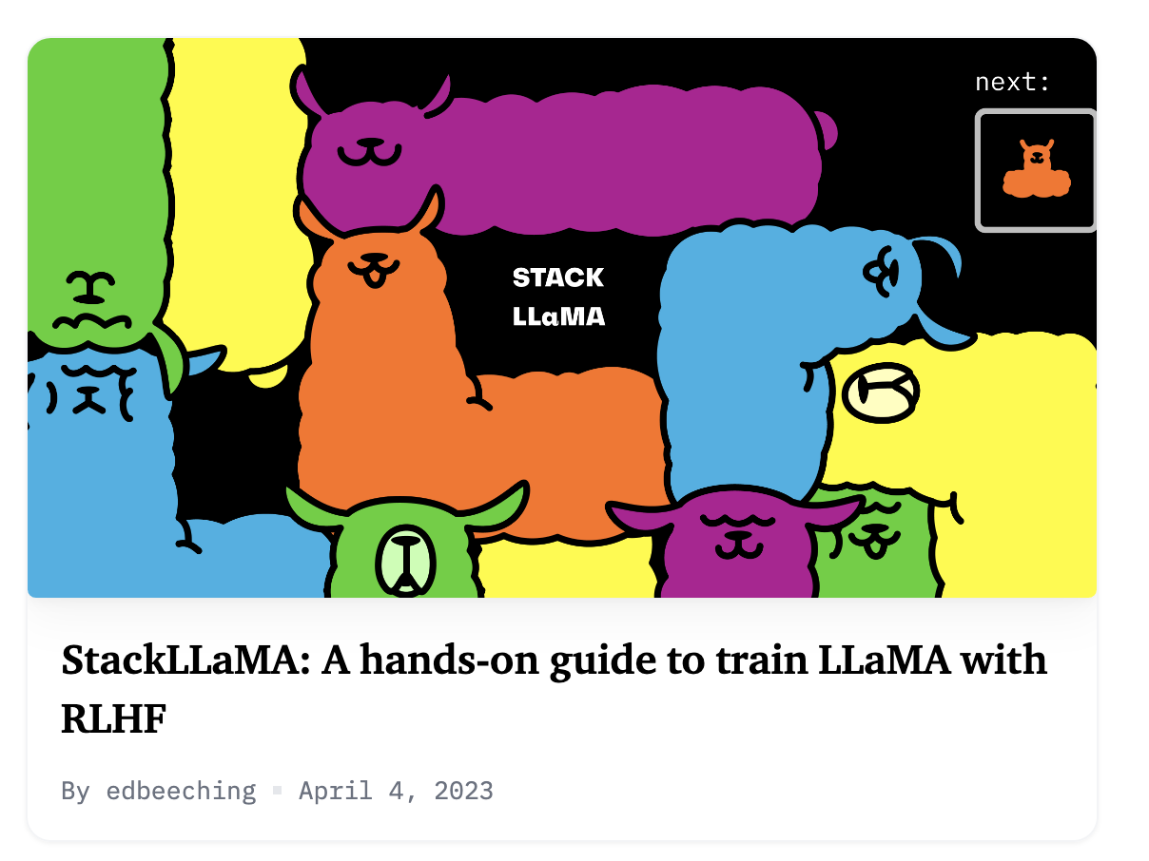
Do LoRA methods work with RL?
Big exploration in late May / summer 2023
Few models that “splashed” trained this way
Likely not a fundamental limitation, but is tricky hyperparameter space
Aligning open language models (Nathan Lambert, April 2024)

Slide 30
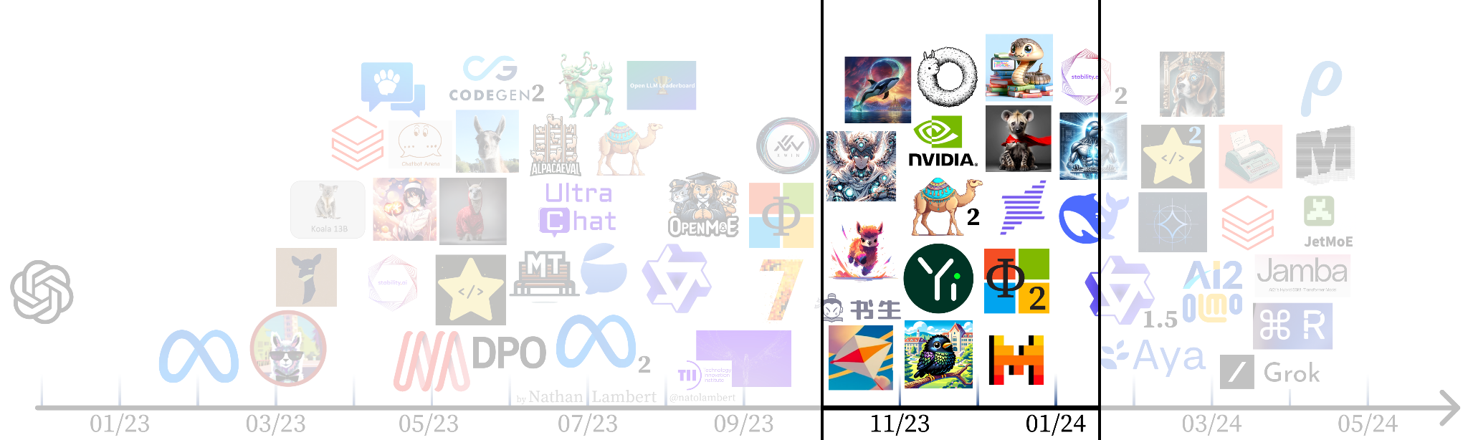
Getting RLHF to work
Aligning open language models (Nathan Lambert, April 2024)

Slide 31
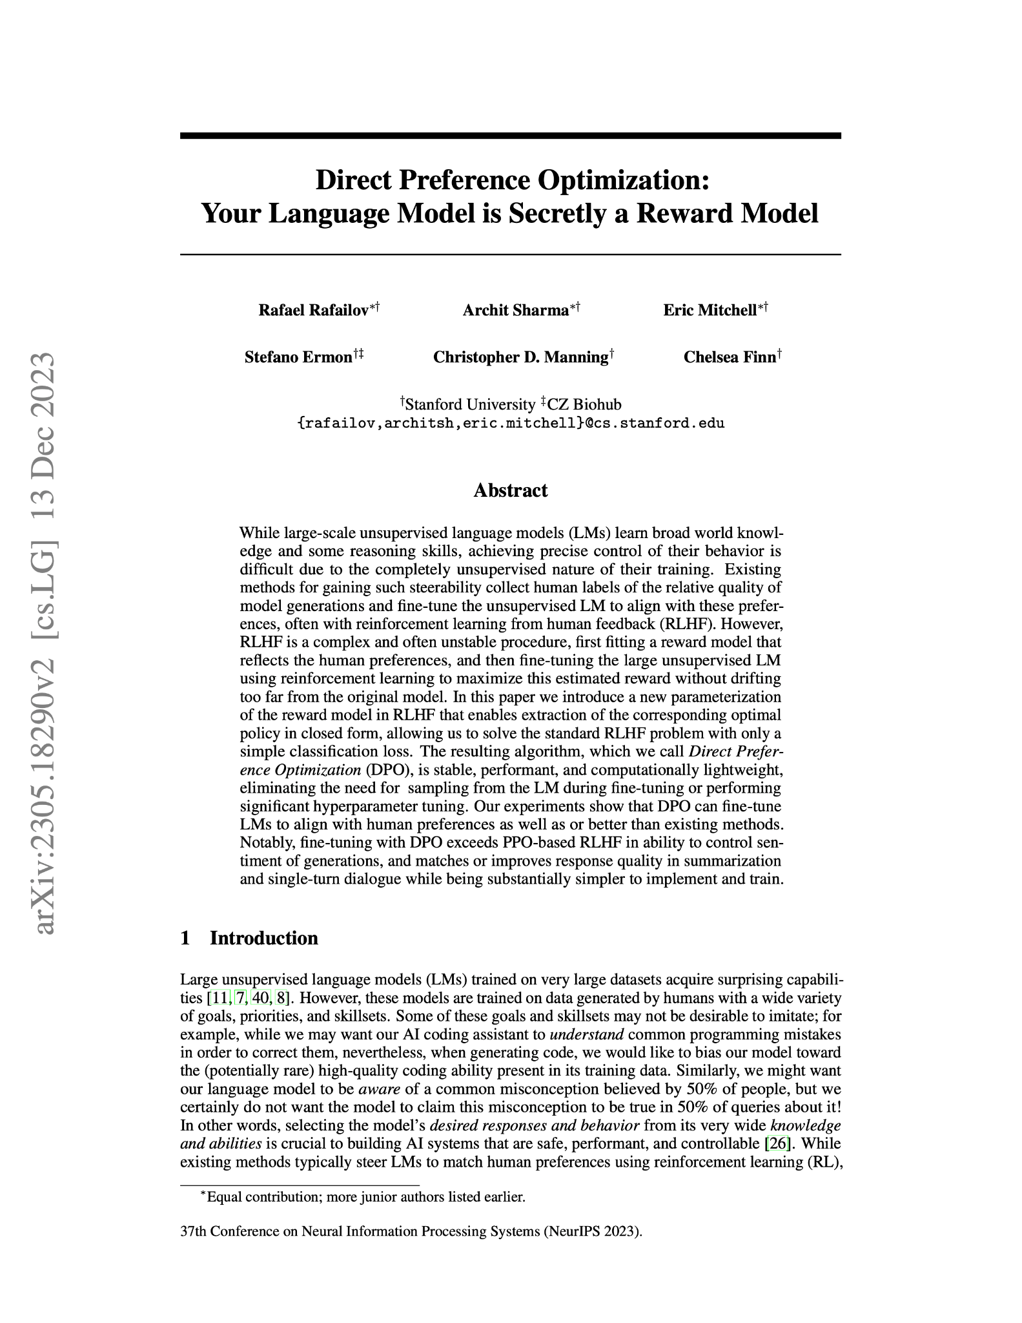
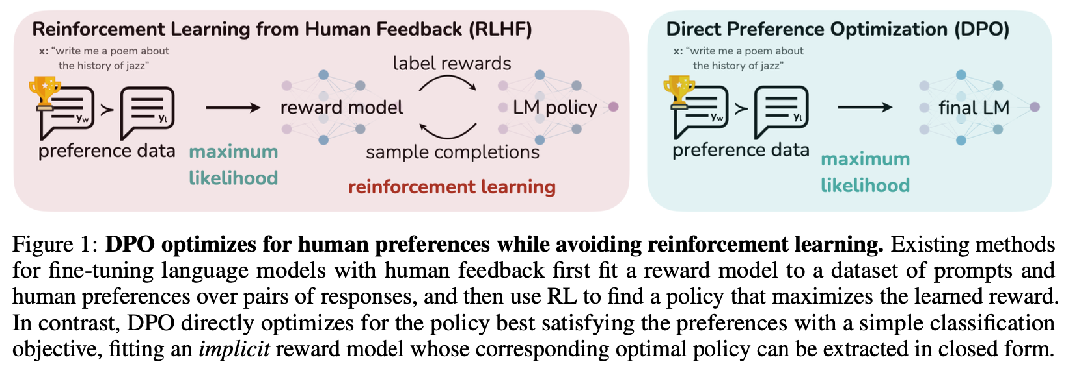
RLHF without online humans in the loop
Direct Preference Optimization (DPO)
May 29th, 2023
Rafailov, Sharma, Mitchell et al. 2023
Aligning open language models (Nathan Lambert, April 2024)

Slide 32

RLHF phase: Zephyr β
First model to make a splash with DPO!
Fine-tune of Mistral 7B with UltraFeedback dataset
MT Bench: 7.34
UltraFeedback: https://arxiv.org/abs/2310.01377
Model: https://huggingface.co/HuggingFaceH4/zephyr-7b-beta
Aligning open language models (Nathan Lambert, April 2024)

Slide 33
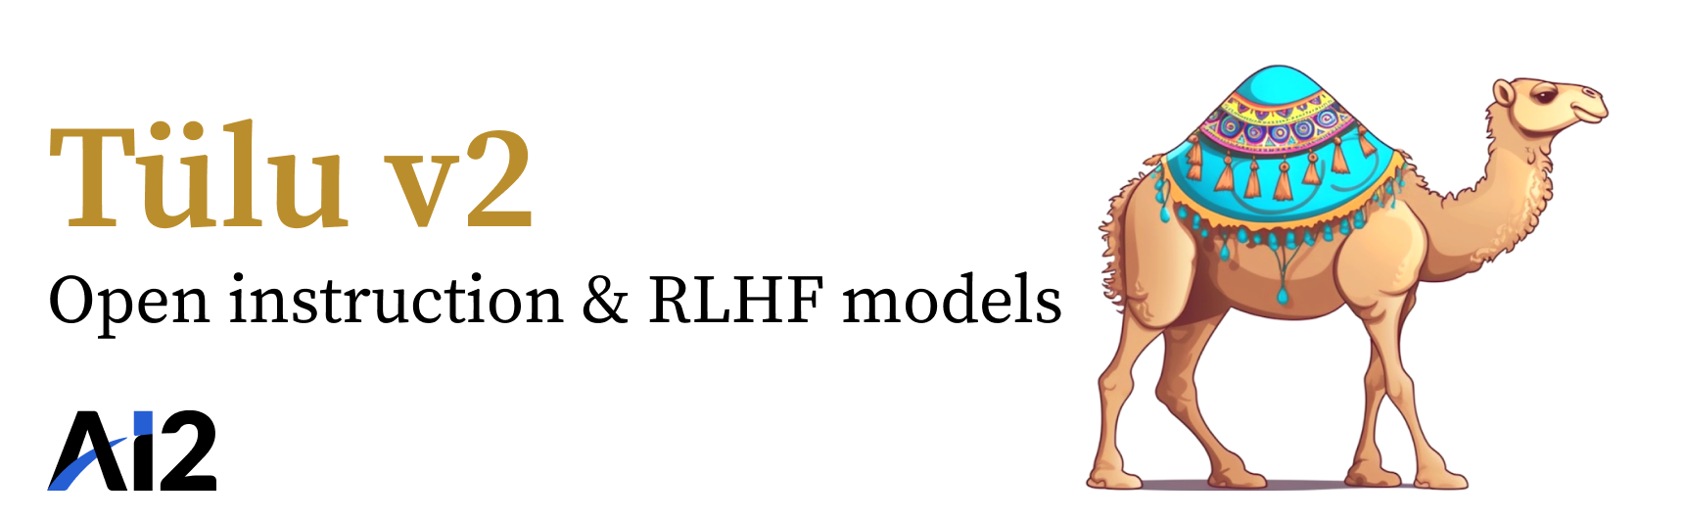
RLHF phase: Tülu 2
First model to scale DPO to 70 billion parameters!
Strongly validated the Zephyr results
MT Bench: 7.89
Model: https://huggingface.co/allenai/tulu-2-dpo-70b
Aligning open language models (Nathan Lambert, April 2024)

Slide 34
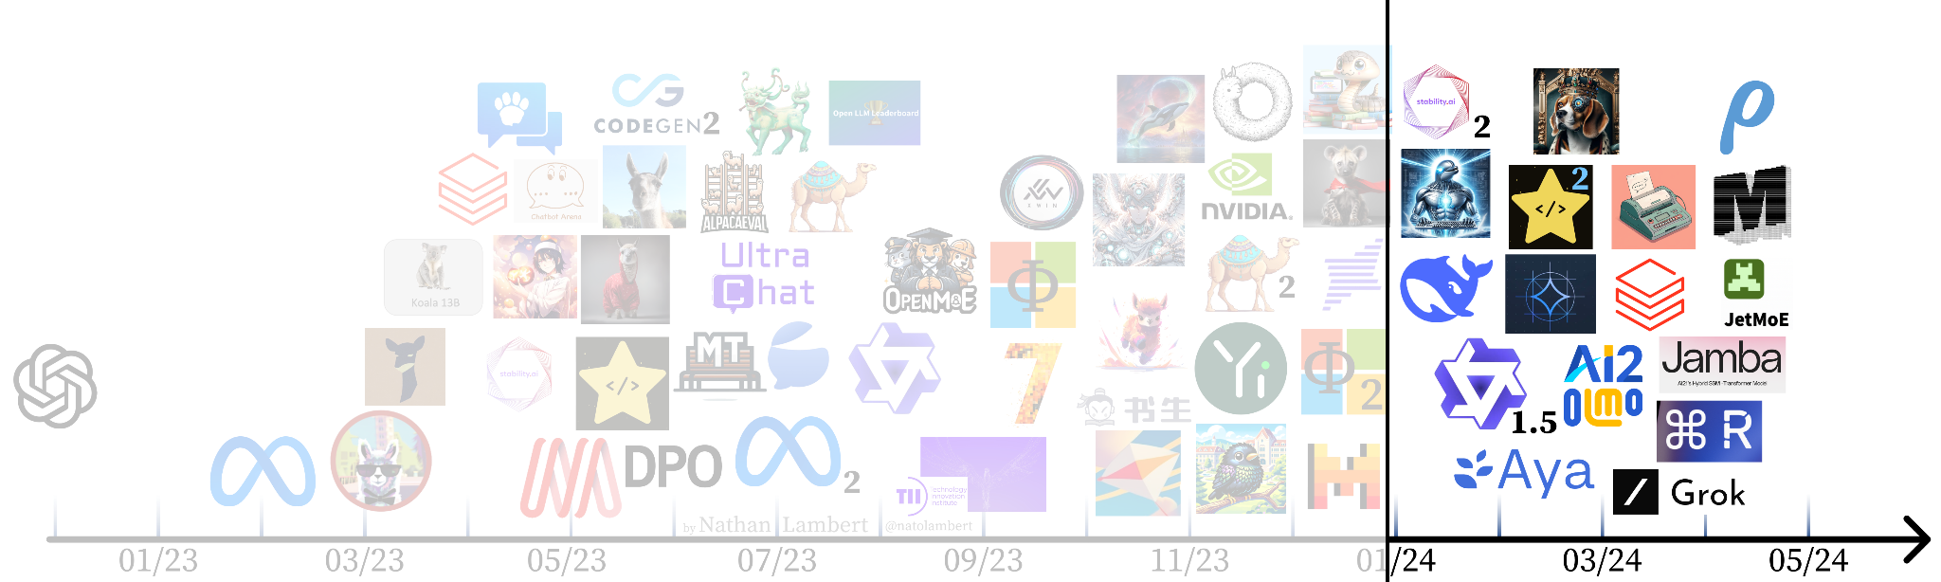
Modern ecosystem
Aligning open language models (Nathan Lambert, April 2024)

Slide 35
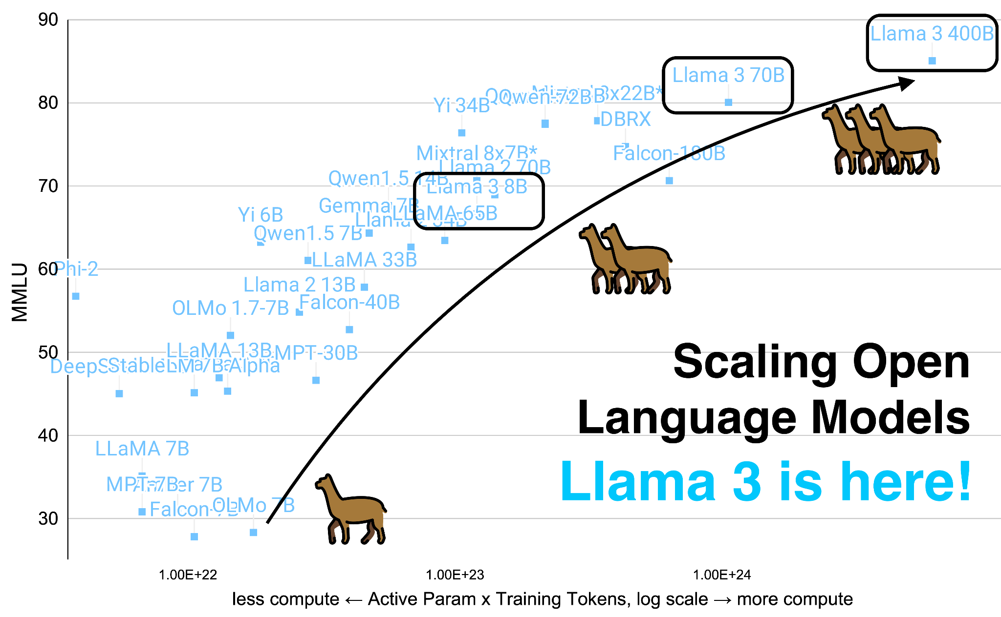
Diversity of models and more players
Examples:
AI2’s OLMo: truly open-source models
Cohere’s Command R+: first open model to pass GPT-4 on ChatBotArena
Multilingual fine-tuning with Cohere’s Aya
Aligning open language models (Nathan Lambert, April 2024)

Slide 36
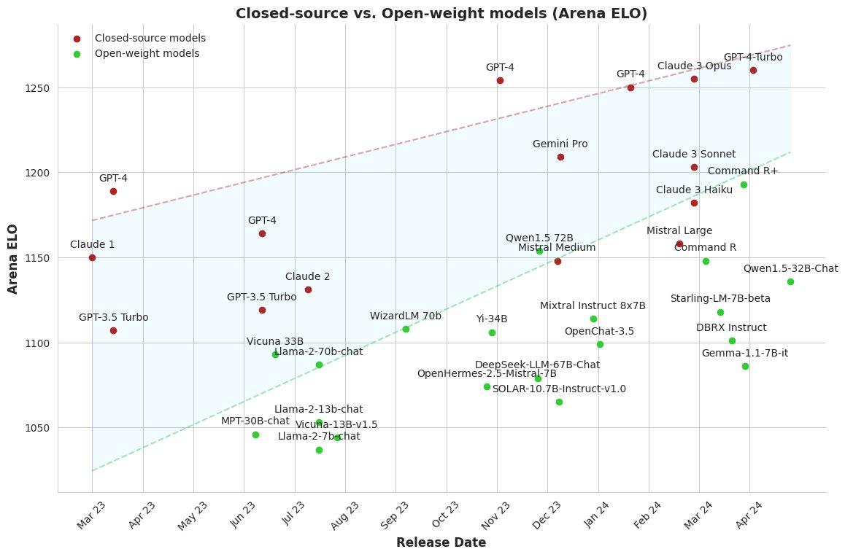
Open vs. closed aligned models
Image credit:
Maxime Labonne
Tulu 2 70B
Aligning open language models (Nathan Lambert, April 2024)

Slide 37
The Danish LM Scene
Danish Foundation Models (Kenneth Enevoldsen, Lasse Hansen, Rasmus Larsen, Dan Saattrup Nielsen, 2024)

Slide 38
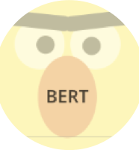



The ”Early" Danish NLP Scene
Pre-november 2022: Encoder-focused (in DK)
Pre-trained models
Ælæctra
DanT5
2017-2018
2020
2022
2019
2022
2022
Danish BERT
DFM-Encoder
ChatGPT
Danish Foundation Models (Kenneth Enevoldsen, Lasse Hansen, Rasmus Larsen, Dan Saattrup Nielsen, 2024)

Slide 39




The (Chat)GPT Effect
Danish Foundation Models (Kenneth Enevoldsen, Lasse Hansen, Rasmus Larsen, Dan Saattrup Nielsen, 2024)
Notes:
Major surge in interest and projects
Neighbours quick to catch on

Slide 40





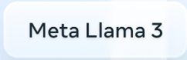


Danish Generative Models
Open models
Closed models
Mainly large tech or motivated individuals!
Danish Foundation Models (Kenneth Enevoldsen, Lasse Hansen, Rasmus Larsen, Dan Saattrup Nielsen, 2024)
Notes:
Open source side: DanskGPT tiny so far (continued pretraining of tiny-llama – Mads also made a non-open source commercial DanskGPT model. DanskGPT also has an instruction tuned cousin.
Of course several more models with multilingual capabilities – these are some of the main ones

Slide 41
Research Efforts
Large European initiative
Open, trustworthy, Germanic LLMs
Danish Foundation Models
Open collaboration within DK
Danish Foundation Models (Kenneth Enevoldsen, Lasse Hansen, Rasmus Larsen, Dan Saattrup Nielsen, 2024)
Notes:
From DK, Alexandra Institute, Copenhagen University, ovelap and collaboration with the DFM project

Slide 42
The Danish LM Scene
Evaluation
Danish Foundation Models (Kenneth Enevoldsen, Lasse Hansen, Rasmus Larsen, Dan Saattrup Nielsen, 2024)

Slide 43
ScandEval: Danish NLU Benchmarking
Tasks:
Information extraction (named entity recognition)
Grammaticality (linguistic acceptability)
Question answering (extractive QA)
Text classification (sentiment classification)
Danish Foundation Models (Kenneth Enevoldsen, Lasse Hansen, Rasmus Larsen, Dan Saattrup Nielsen, 2024)

Slide 44
ScandEval: Danish NLG Benchmarking
Tasks:
Information extraction (named entity recognition)
Grammaticality (linguistic acceptability)
Question answering (extractive QA)
Text classification (sentiment classification)
Summarisation (news summarisation)
Knowledge (translated multiple choice datasets: MMLU and ARC)
Common sense reasoning (translated multiple choice dataset: HellaSwag)
Danish Foundation Models (Kenneth Enevoldsen, Lasse Hansen, Rasmus Larsen, Dan Saattrup Nielsen, 2024)

Slide 45
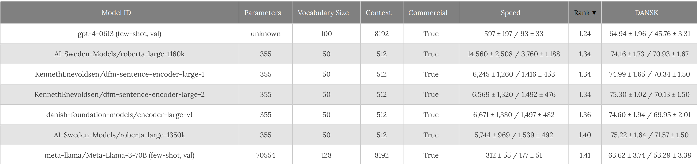
ScandEval: Danish NLU
https://scandeval.com/danish-nlu/
Targeted models can compete with commercial LLMs
This benchmark does not capture
Openness
Energy consumption
Carbon emissions
Danish Foundation Models (Kenneth Enevoldsen, Lasse Hansen, Rasmus Larsen, Dan Saattrup Nielsen, 2024)

Slide 46
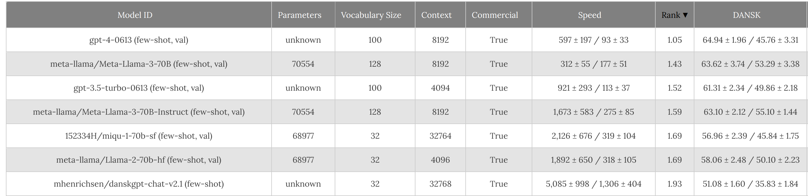
ScandEval: Danish NLG
https://scandeval.com/danish-nlg/
But more bleak for open-source generative models
Note: Models are still being benchmarked so this is not a full picture
Open Questions:
Performance of newer models such as Mixtral, Cohere Command-R, Aya...
Ranking in relation to English benchmarks
Influence of RAG solutions
Danish Foundation Models (Kenneth Enevoldsen, Lasse Hansen, Rasmus Larsen, Dan Saattrup Nielsen, 2024)

Slide 47
ScandEval: Current Limitations
3/8 datasets are translated
To what degree is performance on a translated dataset like a native dataset?
Difference in evaluation and application
Popular model evaluations:
Code generation
…
Danish use-cases:
Tax system, welfare, Danish conditions
“Er jeg berretiget til kørselfradrag hvis jeg kører fra Tyskland på arbejde?”
Danish Foundation Models (Kenneth Enevoldsen, Lasse Hansen, Rasmus Larsen, Dan Saattrup Nielsen, 2024)

Slide 48
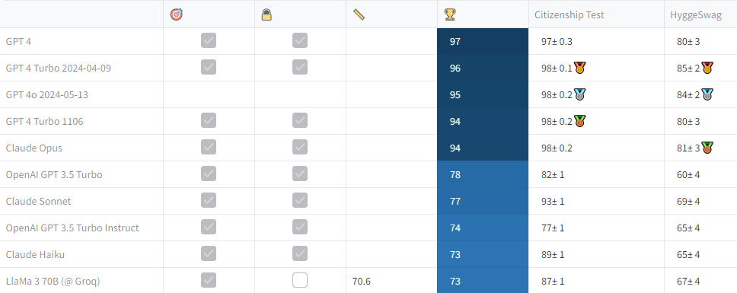
New! Danoliterate GLLM Leaderboard
https://danoliterate.compute.dtu.dk/Leaderboard
Søren Vejlgaard Holm and Lars Kai Hansen, DTU Compute
Martin Carsten Nielsen, Alvenir

Slide 49
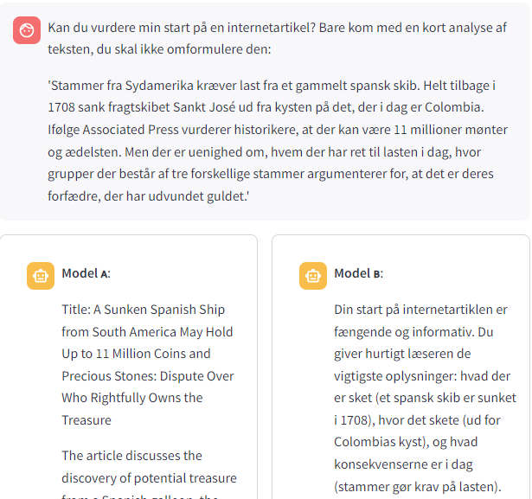
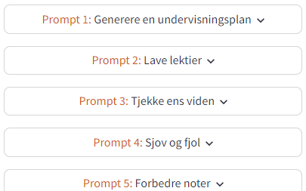
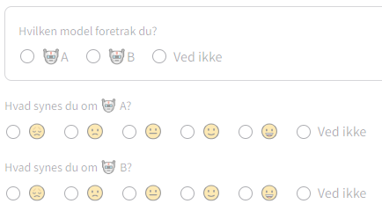
In progress: Danoliterate A/B testing (like ChatBot Arena)
https://danoliterate.compute.dtu.dk/Spørgeskema
Søren Vejlgaard Holm and Lars Kai Hansen, DTU Compute
Martin Carsten Nielsen, Alvenir

Slide 50
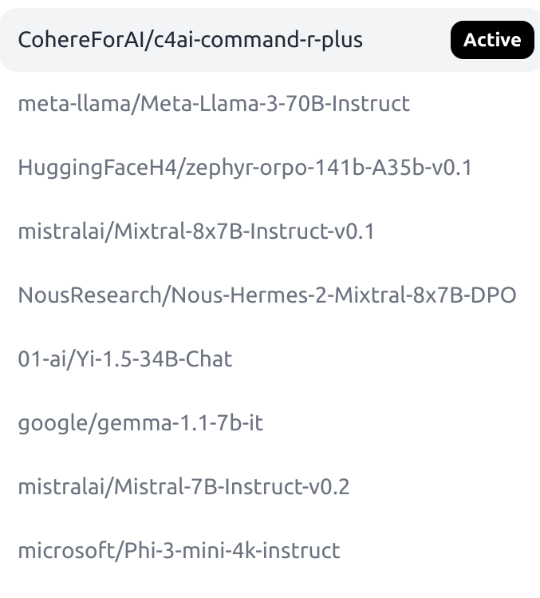
ChatGPT alternatives
DanskGPT (https://chat.danskgpt.dk/)
Large closed model and small open model available
Meta LLaMA further trained on (translated) Danish data
HuggingChat (https://huggingface.co/chat/)
Offers many open-source models of different sizes
Competitive with ChatGPT but not tested on Danish
Rule of thumb: use smaller models if they’re good enough

Slide 51
Strengths and weaknesses
LLMs are really good at
Writing fluent and well-formed language
They are not so good at
Accessing up-to-date knowledge
Explaining their answers
Summarizing long texts
Math (except if using code)
Knowing what they don't know
Writing programming code
...
...
Identifying topics

